Slide 1
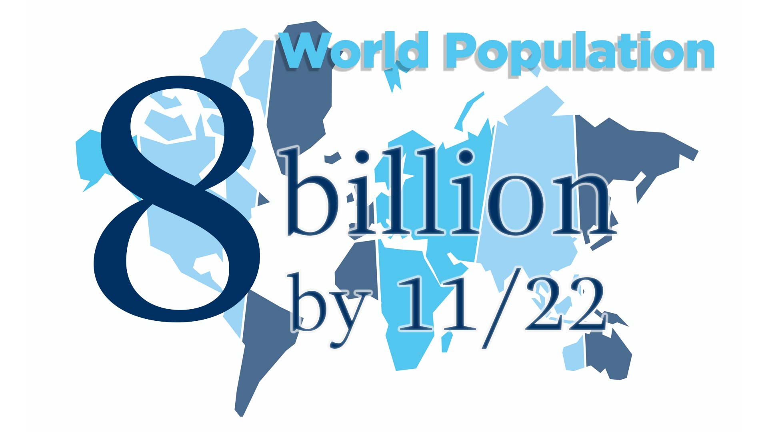
Notes:
The population of the world is growing exponentially at a great rate.
The global human population will reach 8.0 billion in mid-November 2022 from an estimated 2.5 billion people in 1950, adding 1 billion people since 2010 and 2 billion since 1998.

Slide 2
Notes:
Church of God World Missions embraces our commission to go into all the world to share the gospel of Jesus Christ. At the current rate of births, we must be strategic and prayerful to accomplish our purpose.

Slide 3
Notes:
World Missions General Director, M. Thomas Propes, has initiated the creation of Community Missions, as an arm of World Missions, through which churches, pastors, and laity can be unified in the strategy of completing the Great Commission. Community Missions will be comprehensive to reach the last, the least, and the lost.

Slide 4
Notes:
It will be practical as it focuses on three key elements. First, Physical needs such as medical care, nutritious food, and clean water. Secondly, Material needs such as shelter, clothing, and shoes. Thirdly, Spiritual needs of salvation, discipleship, and church planting.

Slide 5
Notes:
It has been said that the Bible way to reach all people, everywhere, can only be done through the involvement of all of God’s people. “A church is responsible for its community, nation, and world.”

Slide 6
Notes:
Just as the bible indicates there are different spiritual giftings for one purpose, the church must realize that one person working one way, will not be able to reach such a diverse humanity -- Old and young. Rich and poor. Gifted and average. Educated and self-taught. Female and male – we must reach to all; each with the gifting of God, the wisdom and understanding He gives, and the discipleship of the church.
Perhaps we narrowly think community signifies unity, a common bond, or geographical significance. But perhaps we should consider community in the broader light of “six degrees of separation,” or that ”anyone on the planet can be connected to anyone through a series of only six social connections.”

Slide 7
Notes:
Our sphere of influence – our common community is both intimate in size and larger in geographical area than we tend to think.

Slide 8
Notes:
Community Missions is an arm of the church to put legs on prayers, helping hands on the wounded and action into the lives of all Christians who must obey the Great Commission.
Who will teach the children to love God and follow in respect to the command to preach the Gospel, heal the hurting, and allow miracles of God to transform the lives of non-believers? Who will prepare and lead teenagers into energetic acts of service for God? Who will young adults follow to be the hands and feet of God in providing gifts from their labor and a powerful eye-opening vision of the fruit of the spirit as their weapon of spiritual warfare.

Slide 10
Notes:
Community Missions and Church of God World Missions will provide Inspiration, Information, and Interaction, keeping you connected with different parts of thse world. We will provide you with a safe way to help finance the work of God. And we will sponsor events and missions trips that assist the work and fellowship of reaching the Last, the Least, the Lost.

Slide 11
